Slide 1

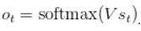
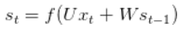
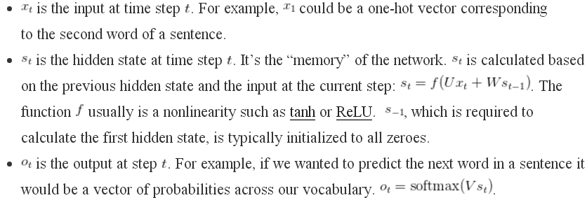

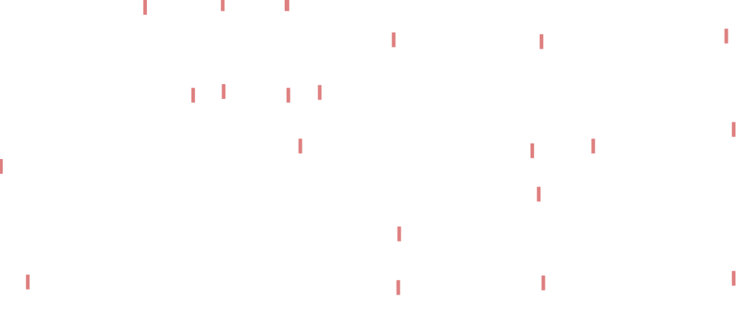
A Typical RNN

Slide 2
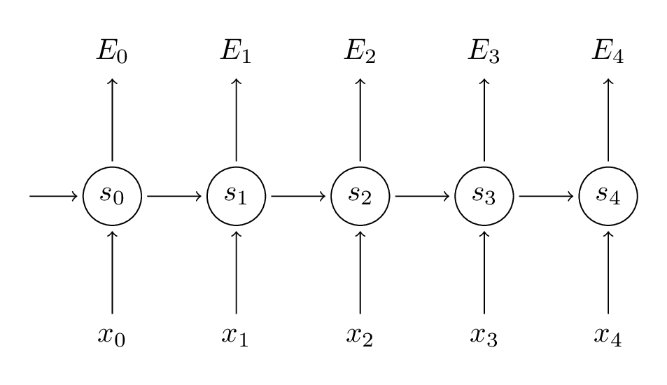
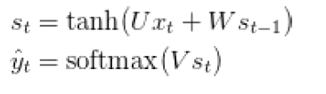
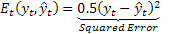
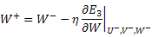
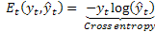
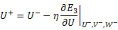
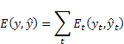
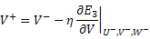
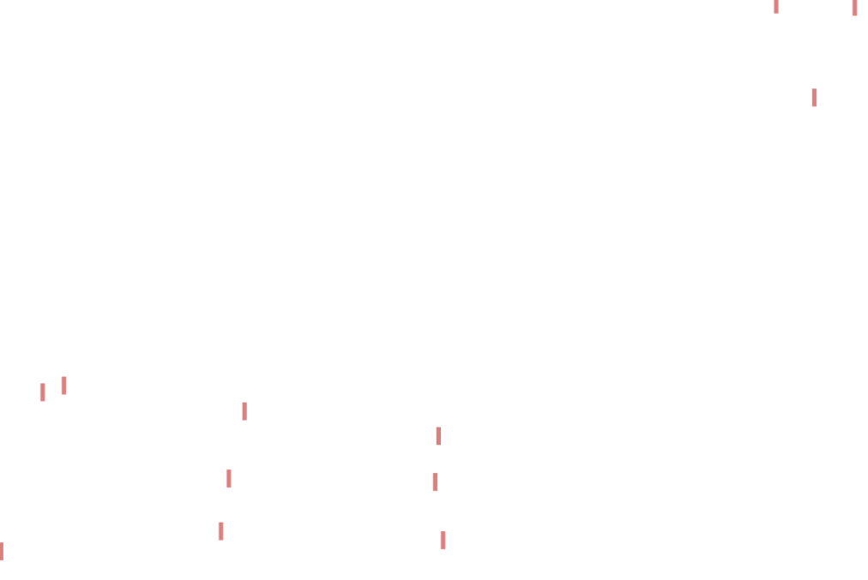
Training RNNs
Back Propagation Through Time (BPTT)
Loss function
Updating Rules(for t=3)

Slide 3
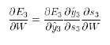
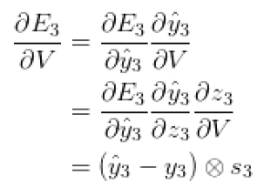
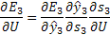
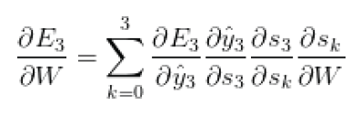
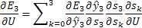
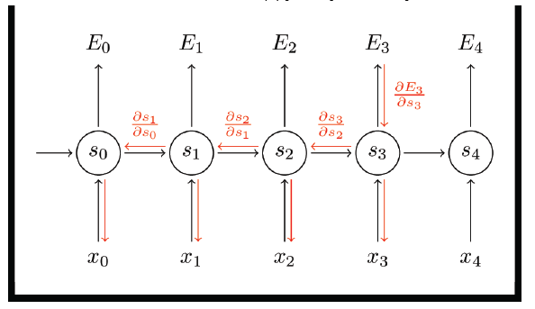
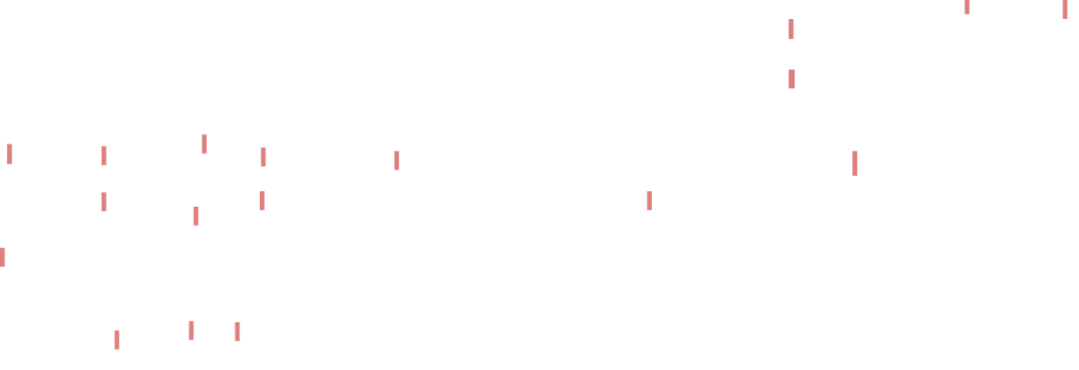
Back Propagation Through Time (BPTT)

Slide 4
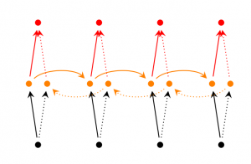
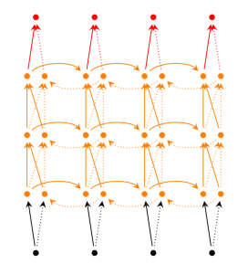
RNN Extensions
Bidirectional RNNs are based on the idea that the output at time may not only depend on the previous elements in the sequence, but also future elements. For example, to predict a missing word in a sequence you want to look at both the left and the right context. Bidirectional RNNs are quite simple. They are just two RNNs stacked on top of each other. The output is then computed based on the hidden state of both RNNs.
Deep (Bidirectional) RNNs are similar to Bidirectional RNNs, only that we now have multiple layers per time step. In practice this gives us a higher learning capacity (but we also need a lot of training data)

Slide 5
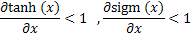
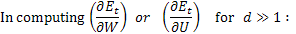
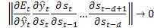

Main limitation in RNN
derivative of sigmoid functions is less than one.
In “BPTT” when the RNN is unfolded for many times the back-propagated gradient coefficient is vanished for the inputs taken at older times.
The learning for long dependencies is not effective any more.
Error gradients vanish exponentially quickly with the size of the time lag between important events

Slide 6
RNNs are good to make Short Term Memory
RNNs are not good to make Long Term Memory
The clouds are in the SKY
implicit input → target
I grew up in France………....I speak fluent French
implicit input →? target
?

